Slide 1
Chapter 12: Managing Marketing Channels
Copyright © McGraw-Hill Education. All rights reserved. No reproduction or distribution without the prior written consent of McGraw-Hill Education.
McGraw-Hill Education
Part 4: Price and Deliver the Value Offering

Slide 2
Learning Objectives
Define value network and how organizations operate within this approach.
Identify various types of intermediaries and distribution channels.
Understand the impact of intermediary contributions via physical distribution functions, transaction and communication functions, and facilitating functions.
Explain the different types of vertical marketing systems.
Utilize suitable criteria to select appropriate channel approaches.
Identify the logistics aspects of supply chain management.
Understand the role of retailing and e-commerce in delivering the value offering to the customer.

Slide 3
The Value Chain and Supply Chain
The value chain portrays a synthesis of primary and support activities utilized by an organization to design, produce, market, deliver, and support its products.
A supply chain is all organizations that supply a firm, the members of its channels of distribution, and its end-user consumers and business users.
Supply chain management is the coordination of these value-adding flows among the entities that maximizes overall value delivered and profit realized.
Notes:
Emblematic of the central role that channel and supply chain issues play in forming the value proposition of modern firms, it is telling that today more and more marketing managers are turning to elements of the “place P” within the 4Ps of the marketing mix for sources of differential competitive advantage.

Slide 4
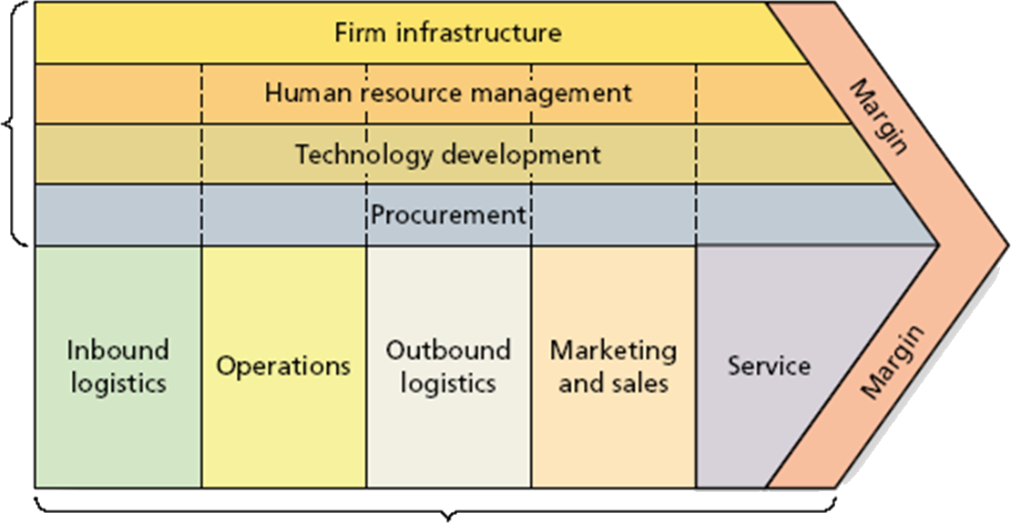
Porter’s Generic Value Chain
EXHIBIT 12.1
Support
Activities
Primary Activities
Link to long alt text description

Slide 5
The Value Chain and Value Networks
A value network is an overarching system of formal and informal relationships within which the firm participates to procure, transform and enhance, and ultimately supply its offerings in final form within a market space.
The aim of the network is value co-creation.
Notes:
Value networks are fluid and complex. They are composed of potentially numerous firms with which a company interacts vertically within its channel of distribution and horizontally across other firms whose contributions are essential to getting the right offering to the right customers. A value network perspective is a macro-level strategic approach that is being adopted by many firms in part because of the intense competition to cut costs and maximize process efficiencies every step of the way to market. The approach suggests opportunities for breaking outside of traditional thinking that marketing is encapsulated within an organization, and instead suggests looking for such opportunities as alliances, strategic partnerships, nontraditional channel approaches, episodic collaborations, and outsourcing opportunities to provide unique sources of competitive edge.

Slide 6
Channels and Intermediaries
A channel of distribution consists of interdependent entities that are aligned for the purpose of transferring possession of a product from producer to consumer or business user.

Slide 7
Major Types of Intermediaries
Intermediaries play a role in the exchange process between producer and consumer.
Middleman | Wholesaler
Merchant middleman | Jobber
Agent | Facilitating agent
Manufacturer’s agent | Retailer
Distributor
Notes:
MIDDLEMAN: Independent business entity that links producers and end-user consumers or organizational buyers.
MERCHANT MIDDLEMAN: Middleman that buys goods outright, taking title to them.
AGENT: Business entity that negotiates purchases, sales, or both but does not take title to the goods involved.
MANUFACTURERS’ AGENT: Agent that usually operates on an extended contract, often sells within an exclusive territory, handles noncompeting but related lines of goods, and has limited authority to price and create terms of sale.
DISTRIBUTOR: Wholesale middleman, found especially when selective or exclusive distribution is common and strong promotional support is needed. Sometimes used synonymously for a wholesaler.
WHOLESALER: Entity primarily engaged in buying, taking title to, storing (usually), and physically handling goods in large quantities. Wholesalers resell the goods (usually in smaller quantities) to retailers or to organizational buyers.
JOBBER: Middleman that buys from manufacturers and sells to retailers. This intermediary is sometimes called a “rack jobber” to connote the service of stocking racks or shelves with merchandise.
FACILITATING AGENT: Entity that assists in the performance of distribution tasks other than buying, selling, and transferring title (examples include trucking companies, warehouses, importers, etc.).
RETAILER: Entity primarily engaged in selling to end-user consumers.

Slide 8
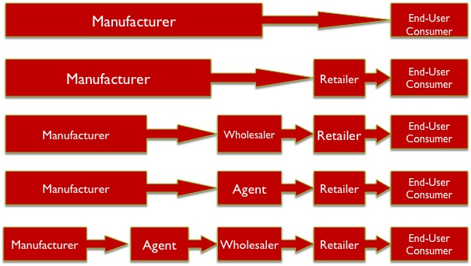
End-User Consumer Channels
EXHIBIT 12.4
Link to long alt text description
Notes:
The exhibits 12.4 and 12.5 call attention to the fact that channels are distinguishable based on the number of intermediaries they contain—the more intermediaries that are involved, the longer the channel. A direct channel, portrayed as the first example in each exhibit, has no intermediaries and operates strictly from producer to end-user consumer or business user. An indirect channel contains one or more intermediary levels, as represented by all the other examples within each exhibit.

Slide 9
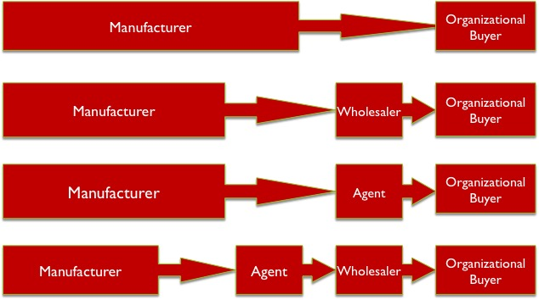
Organizational Channels
EXHIBIT 12.5
Link to long alt text description

Slide 10
Functions of Channel Intermediaries
Functions of Intermediaries
Physical distribution (or logistics) functions | Transaction and communications functions | Facilitating functions
Notes:
One function of channel intermediaries is physical distribution, or logistics, which is the integrated process of moving input materials to the producer, in-process inventory through the firm, and finished goods out of the firm through the channel of distribution.
Another category of intermediary contribution within a channel is the performance of transaction and communication functions.
In a channel, facilitating functions performed by intermediaries include a variety of activities that help fulfill completed transactions and also maintain the viability of the channel relationships.

Slide 11
Channel Intermediaries: Physical Distribution
Physical Distribution Functions
Breaking bulk | Accumulating bulk and sorting | Creating assortments | Reducing transactions | Transportation and storage
Notes:
Breaking Bulk: In many industries, such as consumer health products, when finished goods come off a firm’s production line, the manufacturer packages the individual pieces into large cartons for shipping into the channel of distribution. This is a convenient way for manufacturers to ship out the product. However, consumers shopping in a drugstore, whether a national chain such as Walgreens or an independent pharmacy in your hometown, don’t need to see 144 units of a shampoo or deodorant on a store shelf. The function of breaking bulk occurs within a channel to better match quantities needed to space constraints and inventory turnover requirements.
Accumulating Bulk and Sorting: Intermediaries perform a process of accumulating bulk—that is, they take in product from multiple sources and transform it, often through sorting it into different classifications for sales through the channel. Eggs, for example, might come into a processing house from individual farm operators for sorting by grade and size, then to be packaged and sent on their way to retailers.
Creating Assortments: Intermediaries engage in creating assortments when they accumulate products from several sources and then make those products available down the channel as a convenient assortment for consumers.
Reducing Transactions: Even one intermediary into a channel can contribute to greatly reducing transactions necessary to complete an exchange. While it might seem counterintuitive to those who are not studying marketing management, channels with intermediaries actually tend to save end-user consumers money over what most direct producer to consumer distribution approaches would cost, given the same product. Manufacturers’ costs would skyrocket if they held the responsibility for interfacing with and delivering product to every one of their end users.
Transportation and Storage: Relatively few producers operate their own transportation networks or provide warehousing facilities. Producers make money by pushing finished goods out the door and into the channel of distribution. As such, transportation and storage functions are among the most commonly provided channel intermediary activities.

Slide 12
Functions of Channel Intermediaries: Transaction and Communications
Transaction and Communication Functions
Selling | Buying | Marketing Communication
Notes:
Selling. Often, intermediaries provide a sales force to represent a manufacturer’s product line. This could take the form of manufacturers’ representatives, or brokers, that represent a product line down the channel. Alternatively, the salespeople might work for a wholesaler or retailer.
Buying. Both wholesalers and retailers perform an important function by evaluating products and ultimately simplifying purchase decisions by creating assortments.
Marketing communications. Intermediaries frequently receive incentives from manufacturers to participate in helping promote products in the channel.

Slide 13
Functions of Channel Intermediaries: Facilitating
Facilitating Functions
Financing | Market research | Risk-taking | Other services
Notes:
Financing. Without readily available credit at various stages in the distribution process many channels could not operate. In any given channel, when credit is required by one channel member it may be facilitated by another channel member such as a producer, wholesaler, or retailer, depending on the situation. Alternatively, credit may be facilitated by outside sources such as banks and credit card providers.
Market research. Because intermediaries are closer to end-user consumers and business users than manufacturers, they are in an ideal position to gather information about the market and consumer trends. Collecting and sharing market and competitive information helps members of the channel continue to offer the right product mix at the right prices.
Risk-taking. A big part of how an intermediary can add value is by reducing the risk of others in the channel. Any of the major physical distribution functions described above that are assumed by a channel member comes with potential risks and liabilities.
Other services. Services performed by intermediaries run a gamut of activities such as training others in the channel on how to display or sell the products, repair and maintenance of products after a sale, and providing customized software for inventory management, accounting and billing, and other operational processes.

Slide 14
Disintermediation and E-Channels
Disintermediation, or the shortening or collapsing of marketing channels due to the elimination of one or more intermediaries, is common in the electronic channel.
Outsourcing or third-party logistics (3PL): Many firms outsource to a 3PL so they can focus on the core business.
Notes:
In the early days of e-commerce, many entrepreneurs rushed to market with a website to sell their favorite products. This dot-com boom quickly turned to a bust, however, in part because many of these new-age marketers didn’t understand the basics of distribution channels. Simply opening a website that features a product is one thing, but it’s another thing entirely to invest in the infrastructure and capabilities needed to consistently fulfill orders in a timely and accurate manner.
Today, E-marketers are much more savvy about how they set up and manage their channels and realize that disintermediation may not improve aggregate channel performance. The trend toward more stability in online shopping was facilitated in large measure by the entry of firms such as UPS and FedEx into the market of providing a broad range of integrated supply-chain solutions.

Slide 15
Vertical Marketing Systems
A vertical marketing system (VMS) consists of vertically aligned networks behaving and performing as a unified system.
Chevron (Gasoline) | Dunkin’ Donuts | Walmart
Corporate | Contractual | Administered
Notes:
In corporate VMS, a channel member has invested in backward or forward vertical integration by buying a controlling interest in other intermediaries.
A contractual VMS consists of otherwise independent entities that are bound together legally through contractual agreement. The most famous example of this arrangement is a franchise organization, which is designed to create a contractual relationship between a franchisor that grants the franchise and the franchisee, or the independent entity entering into an agreement to perform at the standards required by the franchisor.
In an administered VMS, the sheer size and power of one of the channel members places it in a position of channel control. The lead player in such situations may be referred to as the channel captain or channel leader, signifying its ability to control many aspects of that channel’s operations. Example: P&G and Walmart power shift.

Slide 16
Channel Behavior: Conflict and Power
Channel power is the degree to which any member of a marketing channel can exercise influence over the other members of the channel.
Channel conflict can occur in which channel members experience disagreements and their relationship can become strained or even fall apart.

Slide 17
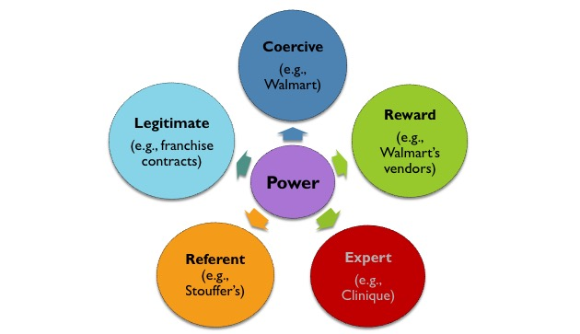
Elements of Power
Link to long alt text description
Notes:
Coercive power involves an explicit or implicit threat that a channel captain will invoke negative consequences on a channel member if it does not comply with the leader’s request or expectations.
Reward power occurs when a firm cannot bypass a channel even though there may be conflict. Most manufacturers want to have their products in Walmart even though it is very rigid in the vendor requirements.
Expert power. Often, channel members adopt an approach of utilizing their unique competencies to influence others in the channel. Expert power might take the form of sharing important product knowledge, such as a representative from Clinique setting up a demonstration for cosmetic consultants in a Nordstrom store to stimulate sales expertise.
Referent power. When a channel member is respected, admired, or revered based on one or more attributes, that member enjoys referent power within the channel. Only the best of the best brands can rely on this power source.
Legitimate power. Legitimate power results from contracts such as franchise agreements or other formal agreements.

Slide 18
Selecting Channel Approaches: Considerations
Among the issues for consideration are:
What is the level of distribution intensity sought within the channel?
How much control and adaptability is required over the channel and its activities?
What are the priority channel functions that require investment?

Slide 19
Selecting Channel Approaches: Distribution Intensity
Intensive Distribution
Maximum exposure
Convenience and impulse goods
Selective Distribution
Shopping goods—fashion, furniture
Exclusive Distribution
Prestige positioning

Slide 20
Channel Control and Adaptability
Marketing managers must take into account:
Cost issues
Accuracy of the sales forecast
Likelihood of major changes
Type of products
Notes:
Hiring an in-house sales force, investing in a fleet of trucks, building a warehouse facility, pursuing a corporate VMS through vertical integration, and engaging in a contractual VMS with other intermediaries each would increase a firm’s control of the channel but at the same time limit its flexibility to change if the competition and other external forces require it. Other options, such as brokers, manufacturer’s agents, and common carriers have the opposite effect in that a firm’s influence and control in the channel is minimized but great flexibility is attained to dramatically and quickly alter aspects of the channel if needed.

Slide 21
Selecting Channel Approaches: Push and Pull
Prioritization of Channel Functions
A push strategy means that much of the intensive promotional activities take place from the manufacturer downward through the channel of distribution.
A pull strategy focuses much of its promotional investment on the end-user consumer.

Slide 22
Logistics Aspects of Supply Chain Management: Physical Distribution
Physical distribution, or logistics, is the integrated process of moving input materials to the producer, in-process inventory through the firm, and finished goods out of the firm through the channel of distribution.
Outbound logistics: from producer to end user.
Inbound logistics: sourcing materials and knowledge inputs.
Reverse logistics: returns due to spoilage, excess inventory damaged goods, customer dissatisfaction, or overstocks.
Notes:
Traditionally, logistics was thought of as an internal flow going one direction—outbound logistics. That is, it was thought that logistics started with production and ended with receipt of the finished good by the end-user consumer or business user. From a supply chain perspective, logistics professionals today tend to take a more holistic view of physical distribution. Thus, along with outbound logistics, it is important to consider inbound logistics—sourcing materials and knowledge inputs from external suppliers to the point at which production begins. Today, the concept of reverse logistics must also be taken into account. Reverse logistics deals with how to get goods back to a manufacturer or intermediary after purchase. Product returns result for many reasons including spoilage and breakage, excess inventory, customer dissatisfaction, and overstocks.

Slide 23
Logistics Aspects of Supply Chain Management: Orders
Order Processing.
Stock-outs.
Enterprise resource planning (ERP) systems software.
Warehousing and materials handling.
Inventory Management.
JIT.
Firms open IT systems for data sharing for better inventory management.
Transportation costs may be 10% of COGS.
Notes:
Receiving and properly processing customer orders is a critical step in getting product moving through the supply chain. It is also a point at which mistakes can easily occur, and when a mistake occurs, and when a mistake occurs in the order, it usually carries through the whole fulfillment system. If the item ordered is in stock, outbound processing from inventory occurs. If the item is not in stock, referred to as a stock-out, then inbound replenishment processes are triggered.
In an ideal supply chain, materials of all kinds are handled as few times as possible. Any warehouse needs to be designed so that after goods are received and checked in, they move directly to their designated storage locations. Efficient, orderly, clean, and well-marked warehouses enhance the flow of goods.
To ensure that inventories of both raw materials and finished goods are sufficient to meet customer demand without undue delay, firms utilize sophisticated just-in-time (JIT) inventory control systems. A JIT system’s goal is to balance the double-edge sword of potentially having too many goods on hand and creating unnecessary warehousing costs, with the chance of having so little inventory in stock that stock-outs occur, requiring expensive rush production and express delivery situations.
With the cost of fuel today, it is not unusual for transportation costs to run as much as 10 percent of cost of goods sold. Effective transportation management is one way that many firms keep a lid on costs while also optimizing delivery options for customers. Inventory in stock that stock-outs occur requiring expensive rush production and express delivery situations.

Slide 24
Comparative Attributes Across Different Transportation Modes
Exhibit 12.7
Low Cost | Speed | Reliability of Delivery | Ability to Deliver to Many Geographical Areas | Reputation for Delivering Undamaged Goods
1. Pipeline | 1. Air | 1. Pipeline | 1. Motor | 1. Pipeline
2. Water | 2. Motor | 2. Air | 2. Rail | 2. Water
3. Rail | 3. Rail | 3. Motor | 3. Air | 3. Air
4. Motor | 4. Pipeline | 4. Rail | 4. Water | 4. Motor
5. Air | 5. Water | 5. Water | 5. Pipeline | 5. Rail
Note: Numbers indicate relative ranking based on general trade-offs of cost versus other attributes of each mode.

Slide 25
Legal Issues in Supply Chain Management
Exclusive Dealing
Intermediary cannot handle competitive products.
Legal when exclusivity is essential for strategic reasons like brand management or when production is limited (e.g., high fashion).
Exclusive Territories
Legal when it doesn’t restrict competition.
Tying Contracts
Requires the purchase of supplementary goods.
Illegal but contracts are written to circumvent laws.
Notes:
When a supplier creates a restrictive agreement that prohibits intermediaries that handle its product from selling competing firms’ products, exclusive dealing has occurred. Whether a particular arrangement is legal depends on whether it interferes with the intermediary’s right to act independently or the rights of competitors to succeed—that is, is competition lessened by the arrangement? Exclusive dealing lessens competition if it (1) accounts for substantial market share, (2) involves a substantial dollar amount, and (3) involves a big supplier and smaller intermediary, which sets up a case for coercion.
An exclusive territory protects an intermediary from having to compete with others selling a producer’s goods. Can a producer always grant an intermediary an exclusive territory for sales purposes? Not necessarily. For this practice to be legal, it would have to be demonstrated that the exclusivity doesn’t violate any statutes on restriction of competition. This issue often manifests itself in the context of suppliers limiting the number of retail outlets within a certain geographic area.
If a seller requires an intermediary to purchase a supplementary product to qualify to purchase the primary product the intermediary wishes to buy, a tying contract is in place. Example: “You can buy my printer, but to do so you must sign a contract to by my ink”—thus, the products are “tied together” as terms of sale. Tying contracts are illegal, but historically it has often been difficult to prove whether an agreement is or isn’t a tying contract in a court of law.

Slide 26
Retailing and E-Commerce
Retailing is any business activity that creates value in the delivery of goods and services to consumers for their personal, non-business consumption and is an essential component of the supply chain.

Slide 27
Electronic Commerce
Traditional brick-and-mortar retailing is migrating online through manufacturers’ websites or via Amazon or other similar sites.
Electronic commerce refers to any action using electronic media to communicate with customers, facilitate the inventory, exchange, and distribution of goods and services, or facilitate payment.
Electronic retailing is the communication and sale of products or services to consumers over the Internet.

Slide 28
E-Retailing: Omnichannel
Omnichannel retailing uses channels including physical stores, online stores, mobile stores, mobile app stores, telephone sales, and any other method of transacting with a customer.
The greatest success in e-retailing is with products where convenience and price are the key drivers of the purchase decision.

Slide 29
E-Retailing
Advantages | Disadvantages
Extensive selection. | Customers walk away easily.
Information available for product research and evaluation. | Reduced ability to sell features and benefits.
Build product communities. | Security of personal data.
Individualized customer experience.
Notes:
Extensive Selection No other channel offers the breadth and depth of selection. From information search to purchase, the Internet gives consumers greater access to more choices and different product options.
Considerable Information Available for Product Research and Evaluation The Internet dramatically expands consumers’ knowledge, offering an almost unlimited number of websites that research, evaluate, and recommend products and services. From retailers (Best Buy in electronics) to independent testing organizations (CNet in technology), consumers can find information on anything.
Build Product Communities The Internet brings together groups of individuals with a shared interest to create virtual communities. These communities share information, ideas, and product information. Babycenter.com offers parents a one-stop source for information about babies, children, and parenting.
Individualized Customer Experience The Internet allows a great deal of personalization for both the consumer and the company. Consumers can get one-on- one interaction from a customer service representative and create their own web content based on personal preferences. At the same time, companies can tailor messages and web content by analyzing consumer web history. The end result is a more customized, personal experience for the consumer.
Easier for Customers to Walk Away The customer is in total control of the web experience and has the opportunity to walk away at any time. In sharp contrast to a personal-selling situation or even a retail store, the customer can simply click to another site. This puts additional pressure on the website to attract and then hold on to visitors. In evaluating a website, one of the key measures is its “stickiness,” which refers to the amount of time visitors remain at the site. A good website not only attracts a lot of visitors, but it also gets them to remain and explore the site.
Reduced Ability to Sell Features and Benefits Websites incorporate sophisticated tools to display and highlight critical features and benefits.
Security of Personal Data Companies work hard to make their websites secure and keep personal data such as credit card numbers private, many consumers still have concerns about the security of their data.

Slide 30
B2B E-Commerce
B2B e-commerce will top $1.1 trillion and be 12% of all B2B sales by 2020.
EDI is required by many companies like Walmart, P&G, and Disney.
Market makers are dedicated sites for the exchange of products and services (e.g., Lending Tree).
Customer communities are sites where customers share stories about vendor experiences (e.g., Adobe, Cisco, Oracle for IT pros and vendors).

Slide 31
Alt Text Appendix
All long alt text descriptions are included in this appendix.

Slide 32
Porter’s Generic Value Chain
Porter's value chain identifies nine value-creating activities, including five that are considered primary activities and four that are identified as support activities. Along the bottom, in vertical rectangles are the primary activities. They are inbound logistics, operations, outbound logistics, marketing and sales, and service. Stacked on top of these are the support activities, which appear in horizontal rectangles. They are firm infrastructure, human resource management, technology development, and procurement. Combined, the primary and support activities relate to margin, which appears in an arrow-like triangle at the far right, is margin.

Slide 33
End-User Consumer Channels
There are many ways to get products from the manufacturer to the end-user consumer. The first is for the manufacturer to sell directly to the consumer. The second channel puts a retailer between the manufacturer and the consumer. Alternately, the manufacturer can sell to a wholesaler, who can sell to a retailer, to can sell to the end-user consumer. Another channel replaces the wholesaler with an agent. In the final channel, all intermediaries are present. Goods move from the manufacturer, to an agent, to a wholesaler, to a retailer, and to the end-user consumer.

Slide 34
Organizational Channels
The most direct way to deliver products to organizational buyers is for the manufacturer to sell to them directly. Another channel moves goods from the manufacturer through a wholesaler to the buyer. In another channel, the wholesaler is replaced with an agent as middleman. In the final channel, a manufacturer moves goods through both an agent and a middleman before they reach the consumer.

Slide 35
Elements of Power
Elements of power can emerge in many ways. They include coercive power (as in Walmart), reward power (as for Walmart's suppliers), expert power (like Clinique), referent power (as Stouffer's), and legitimate power (such as franchise contracts).

